Slide 1
Akamai SOHO Network Proposal
By: Tasnima Akter Anika
Course: Akamai Networking Fundamentals Module 9 - Capstone Project
Date: 21/04/2025

Slide 2
Company Name & Mission
Company Name: Stratify IT Farm
Mission: To provide secure, scalable networking solutions for SOHO clients.

Slide 3
Project Objective
Build internal network for 5 employees.
Enable secure LAN communication and Internet access.
Host a public web server accessible via domain name.
Demonstrate services for potential SOHO clients.

Slide 4
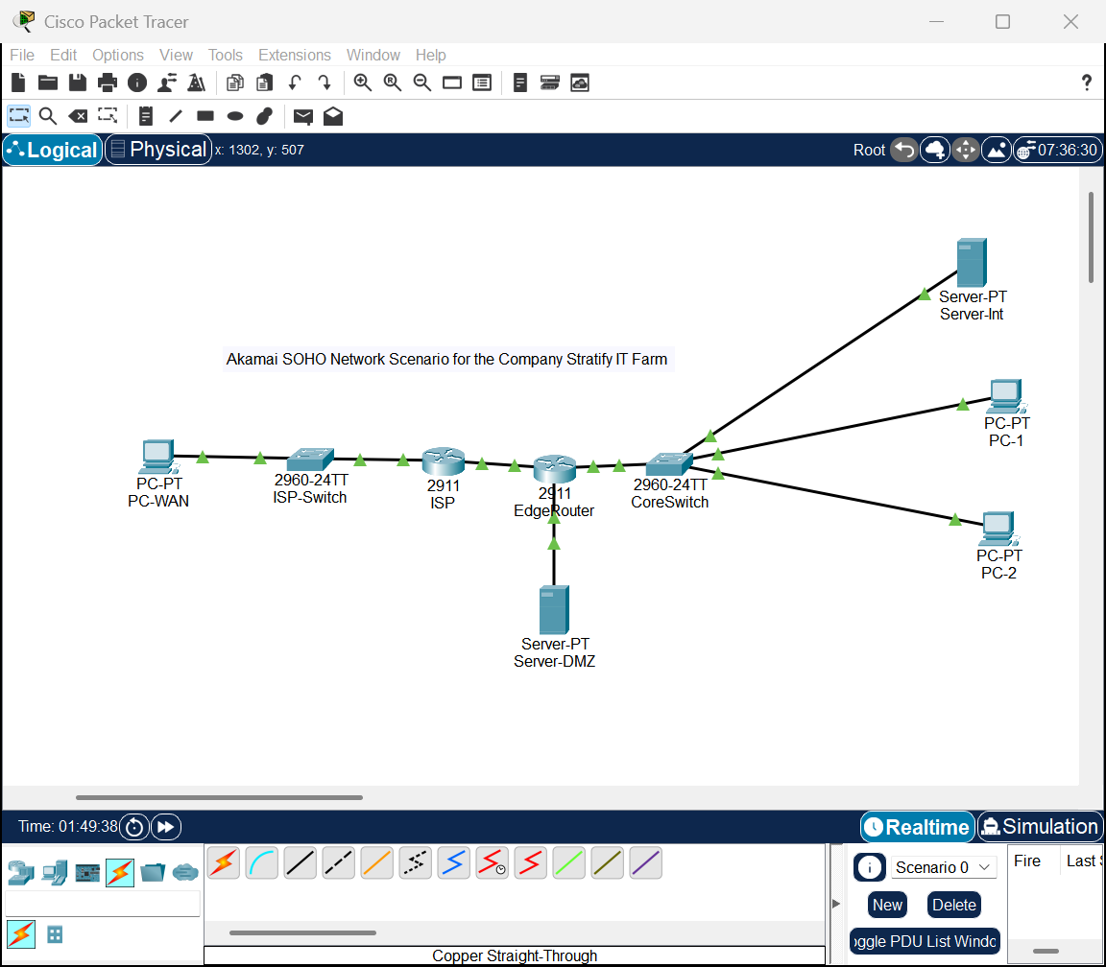
Network Topology
Devices: 2 Routers, 1 Switch, 2 PCs, Internal & Public Servers, External Client.
Screenshot from Packet Tracer

Slide 5
Devices on the Network
Clients: PC0, PC1 (employee workstations).
Servers: Internal DNS/Web & Public Web (DMZ).
Switch: Central LAN backbone.
Routers: EdgeRouter for NAT & ISP simulation.

Slide 6
IP Addressing Scheme
LAN (10.0.0.0/24): PCs & Internal Server.
DMZ (172.16.0.0/24): Public Web Server.
WAN (192.168.100.0/24): EdgeRouter to ISP.

Slide 7
Network Segmentation & Rationale
LAN: Staff devices + services.
DMZ: Public-facing server.
WAN: Simulated Internet.
Separation improves security and performance.

Slide 8
Services Provided
DNS: Internal resolution for www.company.com.
HTTP: Internal and external web pages.
NAT: Public access to web server.
Routing: Static routes used.

Slide 9
Web Access Flow
LAN: DNS resolves www.company.com to DMZ IP.
External: NAT maps public IP to DMZ web server.
Both LAN and external clients access web services.

Slide 10
Configuration Highlights
NAT: ip nat inside source static tcp 172.16.0.10 80 192.168.100.2 80
DNS: www.company.com -> 172.16.0.10
Routes: ip route 10.0.0.0 & 172.16.0.0 via 192.168.100.2

Slide 11
Why This Design Works
Modular and expandable.
Secure with proper segmentation.
Simple for small teams to manage.
Scalable and real-world applicable.

Slide 12
Testing Results
PCs can ping each other: ✅
PC0 accesses internal DNS/Web: ✅
PC0 resolves www.company.com: ✅
External client access via NAT: ✅

Slide 13
Thank You / Q&A
Design shows secure, functional SOHO network.
NetNest offers scalable solutions for real clients.

